Slide 2
Welcome
Form groups of 5-6
On the tables there are stacks of notecards. Throughout the workshop, if you have any questions write them down. We will collect these near the end, and talk through some as a group.

Slide 3
What Have You Noticed about How Americans Act / Interact in Public?

Slide 4
Transportation

Slide 5
The CTA

Slide 6
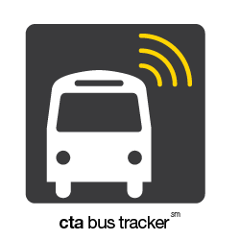
CTA Resources
Phone Apps
You can download these to your phone for free!
CTA Tracker (bus and train)
Transit Stop
iTrans CTA
Transit Buddy
App Icons from iTunes Store
Notes:
CTA Tracker: currently just busses, though the train is in beta
Transit stop: find busses and train times
iTrans: train and bus times, directions, system map, push alerts for service alerts, line diagrams, and street map
Transit Buddy: train and bus times as well as push notifications.

Slide 7
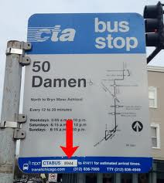
CTA Resources
Twitter (@cta)
CTA Website (transitchicago.com)
If you don’t have a smart phone, you can text 41411 for bus arrival times at your stop.
Image from ascentstage.com
Notes:
The CTA twitter account is great for delays, alerts, advisories, news, etc. They update it regularly, and it’s a great resource to find out whats going on with the CTA

Slide 8
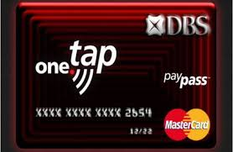
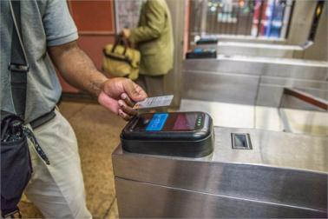
A Note about Using Ventra
Be careful if you have credit cards that use the tap system; you can be double charged.
Ventra image from metro-magazine.com
Credit card image from btinvest.com
Notes:
Ventra cards can be purchased and reloaded at any train station
it is still relatively new, so they are working out a lot of the issues

Slide 9
Riding the CTA
Let people off the bus or train before getting on.
Move all the way in to the bus or train car so others can get on easily.
Offer up your seat for those who may need it.
Prepare your exit strategy
On the bus, it’s easier to exit from the back door

Slide 10
Cabs
http://www.youtube.com/watch?v=uQajOZvQpoQ

Slide 11
Cabs
Cabs run on a meter that charges a base fare, plus additional charges for mileage.
You can pay with cash or with a credit/debit card.
Tipping is generally expected, about 15%-20%

Slide 12
Cab Fare Information
Flag Pull (Base Fare) | $3.25
Each additional mile | $1.80
Every 36 seconds of time elapsed | $0.20
First additional passenger | $1
Each additional passenger after first passenger | $0.50
Vomit Clean-up Fee | $50
Fare info from cityofchicago.org
Notes:
http://www.cityofchicago.org/city/en/depts/bacp/supp_info/2012_passenger_information.html

Slide 13
Cab Resources
Uber
Hailo
Taxi Magic
SnagCab
Lyft
Notes:
These apps generally work the same. Each application will have a certain number of cabs in their network throughout the city. They’ll pull up your current location and the closest cabs (in their network). Some have additional features and options (for example, Uber allows you to get a taxi or a chauffeured car)
You can download them on your phone and use them to call a cab in the network and even pay from the app itself.

Slide 14
Shopping
http://www.youtube.com/watch?v=jJ_dyDKOQ8M

Slide 15
General Shopping Guidelines
Many stores may not allow food or drinks.
Smaller stores may ask you to leave your bags at the counter for security reasons.
Put unwanted items back in their proper place.
Be conscious of others when talking on your phone.
You can go in simply to browse.
Bartering is generally unacceptable.
Notes:
If someone says that you cannot have food or drinks, either leave the store until your beverage is finished and come back later.
The attendant at the counter will watch your bag to make sure no one steals it. They will also give you a token/slip for when you are done shopping to retrieve it.
If you pick something up thinking you’ll buy it, later realizing you don’t want to buy it, don’t just put it down anywhere. Put it back where you found it.
You can also let the cashier know when checking out that you changed your mind about an item; they’ll take it from you and return it later
Browsing: don’t just waste the salespeople’s time. It’s ok to go in and look around, but if someone helps you a great deal, you should purchase something.

Slide 16
Dressing Rooms
Some stores will have a limit of items you can take in.
Some stores have an attendant in the dressing rooms who can help you find different sizes or options and put back the items you do not wish to purchase.
Don’t leave the clothes in the dressing room.
There is often a rack at the entrance to the dressing rooms where you can place the clothes you don’t want to buy.
Notes:
Depending on the store, you may need to get an employee to let you into the dressing room. Simply find an employee and let him or her know you would like a dressing room to try on the clothes you have. At some places, the employees will even get you additional sizes or additional options if you didn’t like what you tried.

Slide 17
Asking for Assistance
It’s ok to ask an employee for help
Employees will often identify themselves
If you aren't sure what exactly you want, they can help you find something.
Its ok to say no to help
Always be polite and courteous!
Notes:
Can you help me find…
I’m looking for…
I’m not sure what I’m looking for (describe what you’re thinking)…
What would you recommend for…

Slide 18
Returns and Exchanges
Most stores allow you to return or exchange items.
How to find out return/exchange rules
When you check out
Store website
Bottom or back of the receipt
Notes:
If you want to return something: don’t take the tags off of clothing, don’t open boxes or sealed containers, don’t use them
Many sale items will not be able to be returned. Final Sale means that you cannot return it
It’s always a good idea to ask what their return policies are

Slide 19
Rewards, Store Credit Cards
You don’t have to sign up
If you are confused, ask for clarification
Benefits
Percentage off of purchase
Free stuff
Disadvantages
Not always clear how it works

Slide 20
Dining in Chicago

Slide 21
Resources to Find Restaurants
Yelp
Urban Spoon
Zagats
Grubhub
Google
Google Maps
Websites
Friends / Classmates
Exploring on your own
Notes:
There are thousands of restaurants in chicago. Finding one can sometimes be easy, but sometimes you may not know where to go.
These resources are great for finding restaurants, narrowing them down to a certain style or cuisine, and even getting review.

Slide 22
Some General Reminders
Some restaurants will take reservations.
Look for a host podium or a sign indicating whether you seat yourself.
If you have questions about the menu, ask your server.
If you are going to split your checks, ask the server before hand.
Notes:
Explain reservations; A note on reservations: you can call the restaurant and ask if they accept reservations; if they do, you don’t necessarily need one, but it’s a great idea.
When you walk in, look for the host/podium/sign. Some ask you to be wait to be seated or say to seat yourself
Servers are a great resource if you are unsure about something on the menus

Slide 23
Tipping

Slide 24
When to Tip
At restaurants when waited on
Bartenders and waitresses
Cab drivers
Food delivery
Hair dressers and barbers
Nail stylists
Notes:
Sometimes it can be tricky to determine if you tip or not.
Here are situations when it is expected that you tip. And again, it all depends on the service, but generally, a 15-20% tip

Slide 25
Museums and Galleries

Slide 26
Museums and Galleries in Chicago
Chicago has tons of museums
Smaller ones are often free, but the bigger Museums—the Field Museum, Shedd Aquarium—charge an admission.
You can find these museums online
Notes:
We’ll talk about resources for finding museums online at the end
There are certain days that museums will have their exhibits open for free

Slide 27
Museum and Gallery Etiquette
Don’t touch any part of the exhibits
No flash photography
Don’t be loud
Don’t eat or drink in the exhibit area
Don’t talk on your phone; keep phone on silent

Slide 28
Some Resources to find things to do

Slide 29
Those Resources
chicago.com
cityofchicago.org
choosechicago.com
chicago.metromix.com
chicagofree.info
Google search what you want to do/see
Many neighborhoods will have their own website: wickerparkbucktown.com, lincolnsqaure.org
Notes:
There are tons of shows, exhibitions, street fairs, concerts, events, etc. in Chicago—especially during spring and summer. There are too many to cover, so we’ll give you some resources to find things to do in the city!
Chicago.com has a ton of events and things to do throughout the city from yoga classes to concerts and street festivals
Chicagofree.info has a lot of free and low cost things to do

Slide 30
Answering Those questions

