Slide 2
Overview
There are many aspects of applying for jobs.
We will focus today on:
Resumes
Cover Letters
Interviews

Slide 3
General Application Info
Most applications will be online.
Often you will fill out forms about your background (education, work, etc.).
You will also be expected to upload a resume, cover letter, and additional materials as requested.

Slide 4
Resumes
Notes:
There are many different types of resumes, for consistency and clarity, we will focus on a basic resume

Slide 5
What is a Resume?
Your resume is a marketing tool.
It promotes / advertises / introduces you as a candidate.
It is a record of your education, work, and experiences.
A resume is a living document.
Notes:
It should be a page
3. It shouldn’t say everything, only the most important and key experiences. Highlights your achievements and experiences.
4. it’s a good idea to have a master list of everything you have done where you keep everything to cut and paste to tailor to each individual job
Employers will read hundreds of resumes, so we now have some tips to make your resume stand out

Slide 6
Formatting a Resume
A resume should be easy to read and navigate.
Separate different elements / experiences / work into different sections.
Within each section you should organize entries from most recent to least recent.

Slide 7
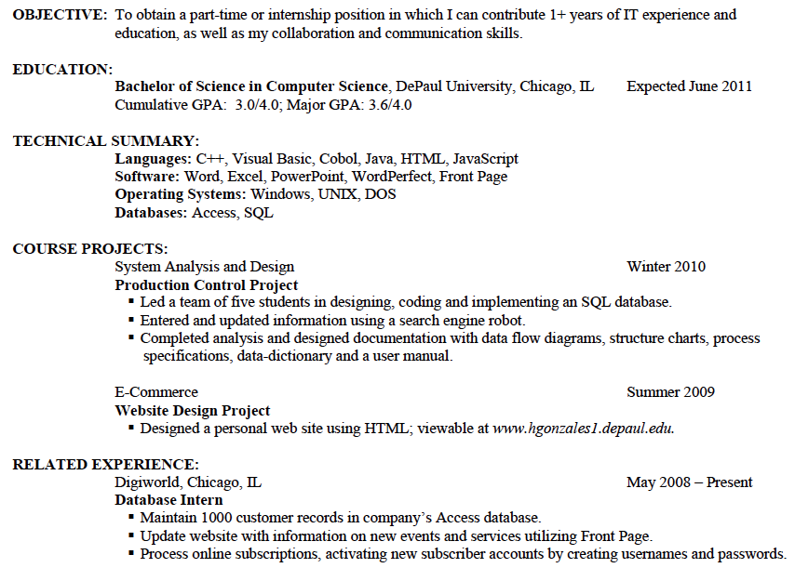
From DePaul Career Center

Slide 8
Formatting a Resume
Employers will scan your resume, so make it easy to find information.
You don’t want to clutter your resume.
White space helps to set information and sections apart.
Notes:
https://www.themuse.com/advice/43-resume-tips-that-will-help-get-you-hired

Slide 9
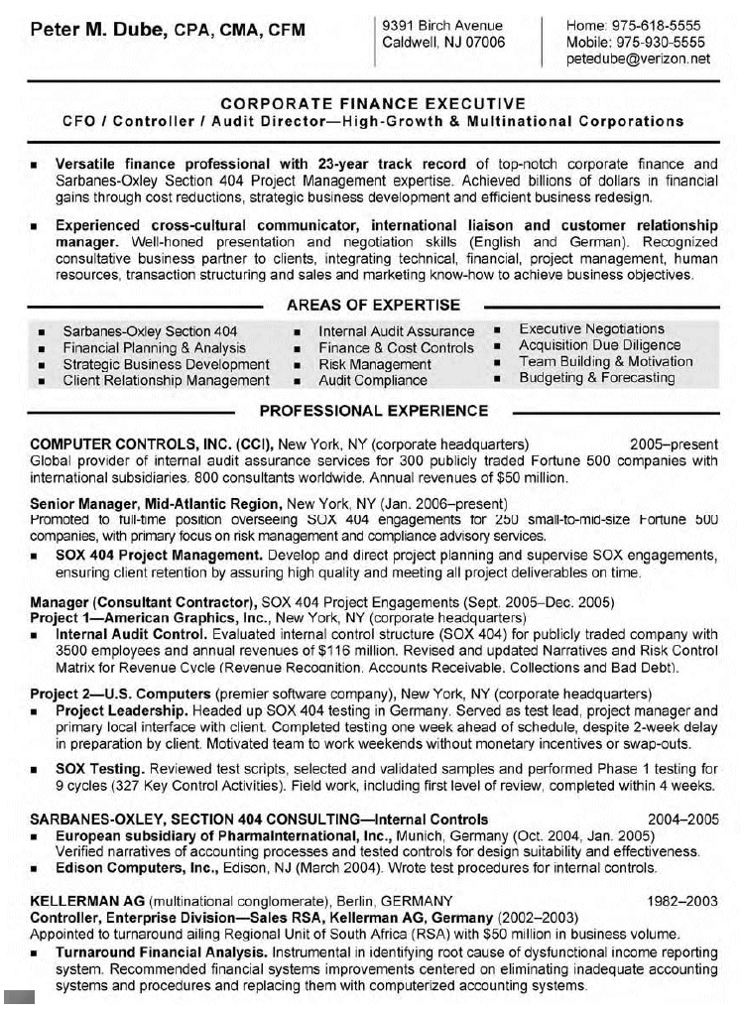
The lack of white space makes this resume hard to scan.
The high amount of text can also make it a little overwhelming for a reader.
Resume from: http://img.bestsampleresume.com/Senior-Manager-Resume.html

Slide 10
From DePaul Career Center

Slide 11
The Content of a Resume
Only include the most important / relevant information and experiences.
Common Sections:
Education
Work
Volunteering
Honors / Achievements
Skills
Notes:
a res should be a living document, so you should change it for each job/application

Slide 12
Language
For each entry, you will also have a brief bulleted list of what you did.
You want to be as clear and concise as possible.
Don’t use “I” at the beginning of bullets.
Don’t use introductory phrases within bullets.

Slide 13
Strong Action Verbs
It is smart to use any verbs that appear in the job posting/description.
Some strong action verbs:
Achieved
Facilitated
Demonstrated
Consulted
Balanced
Led
Managed
Organized
Mentored
Maintained
From DePaul Career Center

Slide 14
Specific and Concrete Language
Use clear language that makes it easy to understand what you did or accomplished.
Include specific details:
Numbers
How often you completed something
The impact of your work

Slide 15
Resume Activity
In small groups, look through these sample resumes. Compare them to one another, considering what we’ve covered so far. Rank them from best to worst. What about them makes them strong or weak resumes?

Slide 16
Cover Letters

Slide 17
A Cover Letter:
Gives a more in depth description of you and your experiences
Connects your resume and other application documents
Demonstrates your writing skills
Discusses why you are an ideal candidate

Slide 18
Elements of Successful Cover Letters
Personalize each cover letter to the specific job.
This is your cover letter, you should talk about yourself.
It’s expected that you will talk about your achievements and why you are a strong candidate.
Try to mirror language / values /
ideas / beliefs from job posting.
Notes:
While a resume is a bulleted list, a cover letter is written in the format of a letter, with paragraphs
1) It’s ok to have a general template, but you should tailor the info to each job. It’s also good to personalize the greeting to a specific hiring manager (if one is provided)

Slide 19
The Introduction of a Cover Letter
Introduce yourself as a candidate.
State what job you are applying for and where you heard about it.
Briefly outline your qualifications.
From DePaul Career Center
Notes:
Look at example

Slide 20
The Body of a Cover Letter
This is your chance to connect yourself to the specific job.
Include your experiences that relate to the position.
Expand on information from your resume that is very important.
Identify specific achievements or qualifications that would be valuable for the company.
Make it clear how you will benefit the company.
From DePaul Career Center
Notes:
Look at example
Explain how your academic background and experience make you a qualified candidate for the position
Point out specific, relevant achievements/ qualifications in your work experience
Try not to repeat the same information the reader will find in the resume
Refer the reader to the enclosed or attached resume or application, which summarizes your qualifications, training, and experience

Slide 21
The Conclusion of a Cover Letter
Mention that you would like to set up a personal interview.
Close your letter with a statement or question that will encourage a response.
Thank the reader for considering you as a candidate.
From DePaul Career Center
Notes:
Look at example

Slide 22
Cover Letter Activity
Get into in small groups.
Using the job posting as your reference, turn this weak and generic cover letter into a strong and specific one.
Write down what you would add in, using information from the strong resume in the previous activity.

Slide 23
Interviews
http://www.youtube.com/watch?v=wkDXWtETy4U

Slide 24
Preparing for Interviews
It is smart to research the company or program before going in.
Do mock interviews with a friend, a Writing Center tutor, or Career Center consultant.
Be ready to explain why you applied for the position and any elements of your application.
Have copies of your resume, cover letter, and references printed for the interviewers.
Notes:
Find out about the interviewer or company (shadowing) if possible
Have questions you’d like to ask

Slide 25
In the Interview
When answering questions, give yourself time to think.
Know when to stop talking.
Make connections between your experiences, application materials, and the program.
Ask questions.

Slide 26
Common Question Categories
Your personal background
Your education and job experiences
Your qualifications
Your knowledge of the job and company
Your personality
Your skills and competencies
Your goals
From: http://passivepanda.com/interview-tips

Slide 27
After the Interview
Thank the interviewer(s) for their time.
Ask about a follow up and timetable.
Thank you notes or emails are a nice touch.

Slide 28
Resources
Writing Center
Career Center
Office for International Students & Scholars (OISS)
International Programs Office

Slide 29
Workshop

