Slide 1
Notes:
Overview of what the workshop will cover.
Define APA (American Psychological Association) and MLA (Modern Languages Association) – we’ll be looking at both. You can choose a focus. We’ll have activities to practice some of what we’re discussing. We’ll leave time for questions at the end to focus on projects you are working on right now.

Slide 2
Image from: http://www.imdb.com/title/tt0204946/
Notes:
http://www.youtube.com/watch?v=F26eQaqwBdg

Slide 3
What is Plagiarism?
Notes:
Ask for volunteers to share their understanding of this concept.

Slide 4
What is Plagiarism?
“The direct copying of any source, such as written and verbal material…whether published or unpublished, in whole or part, without proper acknowledgement that it is someone else's” (DePaul University Office of Academic Affairs, 2012, p. 2).
Notes:
- This isn’t limited to words or ideas, but includes a wide variety of sources: music, paintings, etc.
- This applies to the work of others and any work that you have submitted. Presenting a previous paper as “new” for a different class is considered plagiarism.

Slide 5
What is Plagiarism?
“Submitting as one's own work [any product] that has been prepared by someone else - This includes research papers purchased from any other person or agency”(DePaul University Office of Academic Affairs, 2012, p. 2).
Notes:
The distinction here is that we are talking about an entire piece.
This includes using a website to buy a paper, having a roommate or friend write a paper, etc.

Slide 6
What is Plagiarism?
“The paraphrasing of another's work or ideas without proper acknowledgement” (DePaul University Office of Academic Affairs, 2012, p. 2).
Notes:
Briefly discuss paraphrasing – taking an idea and restating it using your own words. We will go into this more in depth later in the presentation.
Even if you aren’t directly using someone else’s words, you need to cite where the ideas come from.

Slide 7
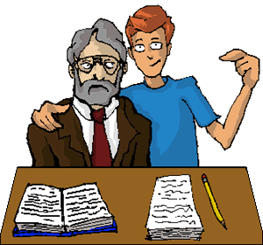
What does it mean to “cite” a source?
Image retrieved from: http://chemistry.berea.edu/lobo2/using/cite/cite2.php
Notes:
Ask who has a definition to share. Be sure to wait an adequate length of time – 15 secs, before calling on people.
Don’t feel the need to correct students on their definitions, but do try to highlight commonalities or contrasts before moving to the next slide with an example.

Slide 8
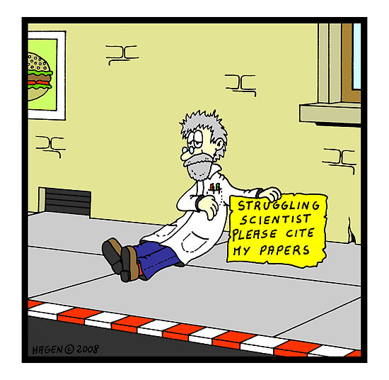
Why do we cite sources?
Image retrieved from: http://educationaltechnologyguy.blogspot.com/2011_02_01_archive.html
Notes:
Ask who has a reason to share. Be sure to wait an adequate length of time – 15 secs, before calling on people.

Slide 9
Why Do We Cite?
To establish your credibility.
To map your research.
To separate your own ideas and words from other people’s ideas and words.
To credit others for the work they have done
Notes:
Credibility: it is good to use other sources to support your ideas and points, and you need to cite them to show your reader where the information came from and to credit and honor the work of others.
When a reader can see where your ideas have come from or what other scholars have supported your ideas they can connect your ideas to a larger discussion and they can find additional information about the topic from your sources.
Making it clear what is coming from you is important for your reader to know what you have created.

Slide 10
Why do we cite?
Originality is very important within American academia:
It is expected that your work (ideas and language) is your own.
What you don’t cite is assumed to be your original thoughts.
Ideas and language are considered
individual intellectual property;
using others’ ideas or language without
citing is considered stealing.
Image retrieved from: http://blog.smallbusinessadvocate.com/intellectual-property/what-does-your-intellectual-property-ip-strategy-look-like
Notes:
-Not citing sources, not giving the person credit, is dishonest and deceitful.

Slide 11
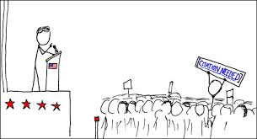
When to Cite
You must cite any ideas or words taken from another source.
How to use someone else’s words or ideas:
Quoting
Paraphrasing
Summarizing
Notes:
Quoting: when you directly copy exact wording from another source
Paraphrasing: when you take ideas from a source and restate using your own words
Summarizing: when you give an overview of the source’s main ideas, using your own words

Slide 12
But What Should Citing Actually Look Like?
Image from: http://chemistry.berea.edu/lobo2/using/cite/cite2.php
Notes:
A reference to a book, an article, a Web page, or another source that provides enough information about the source to allow a reader to retrieve it. Citations in a paper must be given in a standard format (such as MLA, APA, Chicago, or CSE), depending on the discipline in which the paper is written (Hacker & Fister, 2010).
Mention that there are several different styles of formatting, we’ll be discussing and using examples from the two most common MLA and APA.

Slide 13
Citing actually has two parts

Slide 14
This Is an APA Citation
In-text Citation:
“Many students simply do not grasp that using words they did not write is a serious misdeed” (Gabriel, 2010).
Bibliographic Citation at the End:
Gabriel, T. (2010, August 1). Plagiarism lines blur for students in digital age. The New York Times. Retrieved from http://www.nytimes.com/
Notes:
Laura to bring book of funny quotes to use for all quoting – this will simplify citation as well.

Slide 15
This Is an MLA Citation
In-text:
“Many students simply do not grasp that using words they did not write is a serious misdeed” (Gabriel).
Bibliographic Citation at the End:
Gabriel, Trip. "Plagiarism Lines Blur for Students in Digital Age.” New York Times. N.p., 1 Aug. 2010. Web. 3 Oct. 2013.

Slide 16
A Citation Has Two Parts
An in-text citation means nothing by itself!
The in-text citation points to the bibliographic citation at the end, which a reader can use to find your original source.
Notes:
Use this to refer back to the reasons why we cite (contextualize why this matters).
Refer them to handout.

Slide 17
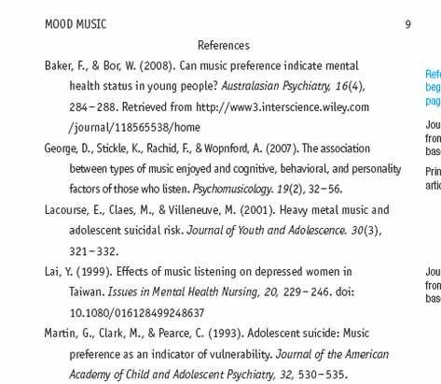
A P A
Image from: http://ebooks.bfwpub.com/smhandbook7e.php
Notes:
http://ebooks.bfwpub.com/smhandbook7e.php

Slide 18
M L A
Image from: http://ebooks.bfwpub.com/smhandbook7e.php

Slide 19
Part I: In-Text Citations

Slide 20
Your Text: Other Voices
Summary
Broad overview of main ideas
Paraphrase
Specific passage restated using different language
Direct Quote
Specific passage repeated word for word

Slide 21
General Guidelines for Incorporating Sources
Introduce the quote, paraphrase, or summary so that it connects to your ideas and lets us know where it comes from.

Slide 22
General Guidelines for Incorporating Sources
Some common verbs used to introduce quotes, paraphrases, or summaries include:
claimed, wrote, argued, contended, noted, stated, and found (APA uses the past tense)
OR, claims, writes, argues, contends, notes, states, and finds (MLA uses the present tense)

Slide 23
General Guidelines for Incorporating Sources
Provide an in-text citation at the end of the sentence.

Slide 24
Introducing Your Quote, Paraphrase, or Summary
Often you will want to introduce the author and his/her credentials as well as the title of the work you are quoting – this helps give your readers a reason to trust the credibility of the source.
Notes:
This is true only the first time you cite, you don’t need to rename them and the text again and again. Also, sometimes you will want to incorporate passages without providing all this info -

Slide 25
Introducing Your Quote, Paraphrase, or Summary
APA
In their chapter, “Writing in U.S. Academic Contexts,” applied linguists Matsuda and Tardy (2008) stated that “[t]he expectations for college writing are often taken for granted by instructors” (p. 782).
Credentials
Authors
Title
Notes:
Point out the use of “states as a strong verb.”

Slide 26
Introducing Your Quote, Paraphrase, or Summary
MLA
In their chapter, “Writing in U.S. Academic Contexts,” applied linguists, Matsuda and Tardy state that “[t]he expectations for college writing are often taken for granted by instructors” (782).
Credentials
Authors
Title
Notes:
Point out the use of “states as a strong verb.”

Slide 27
Introducing Your Quote, Paraphrase, or Summary
APA
The reality we find is that “[i]n a society that is as diverse in linguistic, cultural, and national origins as the USA, it is inevitable that language would eventually become a source of conflict in education,” as indeed it has (Fillmore, 2004, p. 340).
Quote is blended into your own sentence
Author and year are now provided in the citation at the end

Slide 28
Introducing Your Quote, Paraphrase, or Summary
MLA
The reality we find is that “[i]n a society that is as diverse in linguistic, cultural, and national origins as the USA, it is inevitable that language would eventually become a source of conflict in education,” as indeed it has
(Fillmore 340).
Quote is blended into your own sentence
Author now named in the citation at the end

Slide 29
Direct Quotes
Use exact words from
another source
Notes:
For both APA and MLA you should:
Place the text you are quoting in “quotation marks”
Provide the Author’s last name
Provide the page number if available
Include a phrase that introduces the text:
MLA: Smith notes that citing is “an important aspect of academic writing” (4).
APA: Smith (2013) notes that citing is “an important aspect of academic writing” (p. 4).

Slide 30
Special Rules for Incorporating a Direct Quote
Place the passage in quotation marks.
Use brackets [ ] and ellipses … to show modifications.

Slide 31
Direct Quote in APA
The quote is placed inside quotation marks
The brackets show a change to the original capital letter
The reality we find is that “[i]n a society that is as diverse in linguistic, cultural, and national origins as the USA, it is inevitable that language would eventually become a source of conflict in education,” as indeed it has (Fillmore, 2004, p. 340).
Citation goes at the end of the sentence
The author(s)
Year of publication
Page number

Slide 32
Direct Quote in MLA
The quote is inside quotation marks
The brackets show a change to the original capital letter
The reality we find is that, “[i]n a society that is as diverse in linguistic, cultural, and national origins as the USA, it is inevitable that language would eventually become a source of conflict in education,” as indeed it has (Fillmore 340).
Citation goes at the end of the sentence
The author(s)
Page number

Slide 33
Modifying Quotes with Brackets
Original passage: "Reading is also a process and it also changes you."
Modified: Margaret Atwood wants her readers to realize that "[r]eading is also a process and it also changes [them]" (30).

Slide 34
Modifying Quotes with Ellipses
Original passage from Author Mary Louise Pratt: In his landmark book, Anderson observes that with the possible exception of what he calls primordial villages, human communities exist as imagined entities in which people will never know most of their fellow-members.
With Omission: As Pratt notes, "Anderson observes that . . . human communities exist as imagined entitles in which people will never know most of their fellow-members” (582).

Slide 35
Practicing Quoting ActivITY 1

Slide 36
Paraphrase
States ideas from an original source but not the author’s original words.

Slide 37
Special Rules for Incorporating a Paraphrase
Do not place the paraphrase in quotation marks.
You may sometimes want to keep a specific word or phrase of the author’s original language by placing it in quotes within your paraphrase.

Slide 38
Guide to Constructing a Good Paraphrase
Keep the author’s main ideas; don’t stray from the main point.
Use your own words.
Use your own sentence structure.
Include especially memorable language in quotation marks
Keep your comments, notes, and explanations separate.

Slide 39
Example of a Good Paraphrase
Original Passage: In a society that is as diverse in linguistic, cultural, and national origins as the USA, it is inevitable that language would eventually become a source of conflict in education.
Paraphrase: Language within education is a contentious subject because of the level of diversity within the United States (Fillmore, 2004, p. 340).
Paraphrase: Language within education is a contentious subject because of the level of diversity within the United States (Fillmore 340).
Notes:
Note that Paraphrase 1 is in APA and Paraphrase is in MLA

Slide 40
Practicing Paraphrasing ActivITY 2

Slide 41
Part II: Bibliographic Citations at the end of your text

Slide 42
A P A
Image from: http://ebooks.bfwpub.com/smhandbook7e.php

Slide 43
M L A
Image from: http://ebooks.bfwpub.com/smhandbook7e.php

Slide 44
A Helpful Handout
Applying This Workshop to Your Own Work

Slide 45
Remember that…
It is always your responsibility to find out the citation style used for the class and learn its rules. Your professor may not directly address this!
Notes:
Define bottom line
With the last bullet: mention that students should ask their prof, use reference books/websites, COME TO THE WRITING CENTER!!!

Slide 46
Get Help If…
You have any questions or any doubts about how to cite a source!

Slide 47
Where to Find Help
This Workshop’s handout!
Ask your instructor
Come to the Writing Center
Visit the reference desk at the library
Use online sources:
The Purdue OWL
APA Style (Blog)
Notes:
Refer them to the hand out and list of typical curve-balls to watch out for, then use Purdue OWL to demonstrate how to find answers.
http://www.apastyle.org/
http://blog.apastyle.org/

Slide 48
References
DePaul University Office of Academic Affairs. (2012). Academic integrity policy. Retrieved from DePaul University, Office of Academic Affairs website: http://offices.depaul.edu/oaa/faculty-resources/teaching/academic-integrity/Documents/AcademicIntegrityPolicy_2012.pdf
Gabriel, T. (2010, August 1). Plagiarism lines blur for students in digital age. The New York Times. Retrieved from http://www.nytimes.com/
Lunsford, A. A. (2008). St. Martin's Handbook (6th ed.). Boston: Bedford/St. Martin's.
Stolley, K., Brizee, A. & Piaz, J. (2013, June 7). Overview and contradictions. Retrieved from http://owl.english.purdue.edu/owl/resource/589/01/

