Slide 1
MLA Style Citations

Slide 2
WORKSHOP GOALS
Understand the importance of citing and documenting sources in academic writing
Determine when to summarize, paraphrase, and/or directly quote in academic writing
Practice citing sources using MLA Style

Slide 3
INTEGRATING SOURCES: WHY?
Provides evidence for your argument and enhances credibility and persuasiveness
Demonstrates your interaction with others in the field and their ideas
Avoids plagiarism and allows readers to locate your sources
http://unitproj.library.ucla.edu/col/bruinsuccess/03/02.cfm

Slide 4
INTEGRATING SOURCES: HOW?
Whenever you use words, data, or ideas from another source in any of the following forms:
Summary
Paraphrase
Direct quotation

Slide 5
USING SOURCES: SUMMARY
Emphasizes points over details
Reduces a large text into a smaller text, in your own words
Fits original text into the context of your writing

Slide 6
USING SOURCES: PARAPHRASE
Captures important details of a text in your own words
Modifies the original language of a text to match the context of your writing

Slide 7
USING SOURCES: DIRECT QUOTATION
Maintains the author’s original phrasing word for word to:
Display particularly poignant or articulate expression
Highlight the author’s opinion
Demonstrate contrasting perspectives

Slide 8
SIGNAL PHRASES
Signal phrases can reveal intention and credibility of sources
Examples:
As Yanovski and Yanovski noted…
Hoppins and Taveras, topical researchers, pointed out that…
Author McDuffie has offered an argument about this view:…

Slide 9
MLA CITATION STYLE
Typically used in Humanities (English, Religious Studies, etc.)
Prioritizes the author’s name as the owner of their ideas
As indicated by signal phrases & in text citations

Slide 10
MLA IN-TEXT CITATION
In-text Citation:
Didion describes that the night after her husband's unexpected death was “the beginning of my year of magical thinking” (33).
Signal Phrase
Page number

Slide 11
MLA IN-TEXT CITATION
With a signal phrase:
Michael Paulson wrote in the New York Times, Odom “hungered to join the Hamilton cast because he recognized the ambition of the lyrics, the appeal of the music, and the drama of the story.”
Without a signal phrase:
Leslie Odom, the start of Hamilton, joined the show because “he recognized the ambition of the lyrics, the appeal of the music, and the drama of the story” (Paulson).

Slide 12
MLA CITATION STYLE
 | Core Elements
1 | Author.
2 | Title of Source.
3 | Title of container,
4 | Other contributors,
5 | Version,
6 | Number,
7 | Publisher,
8 | Publication date,
9 | Location.
If your text is located within another “container” (i.e.: database, anthology, etc.), add elements 3-9 at the end for each additional container.
Omit any irrelevant elements
Follow each element with the punctuation mark shown (unless it is the final element, then use a period!)

Slide 13
MLA CITATION STYLE
 | Core Element | Example:
1 | Author. | Joan Didion.
2 | Title of source. | The Year of Magical Thinking.
3 | Title of container,
4 | Other contributors,
5 | Version,
6 | Number,
7 | Publisher, | Alfred A. Knopf,
8 | Publication date, | 2005.
9 | Location.
Works Cited
Didion, Joan. The Year of Magical Thinking. Alfred A. Knopf, 2005.

Slide 14
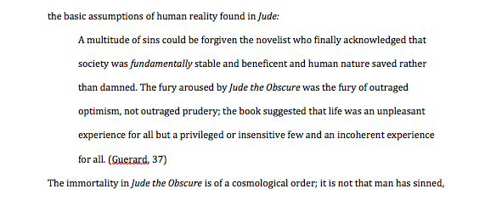
MLA CITATION: BLOCK QUOTES
colon
Indented ½ inch
Parenthetical citation after the quote

Slide 15
CITATION PRACTICE
Get into groups of 2-3. For each of the following sources, create a Works Cited entry in MLA format
*Use the Purdue OWL if you need extra guidance!

Slide 16
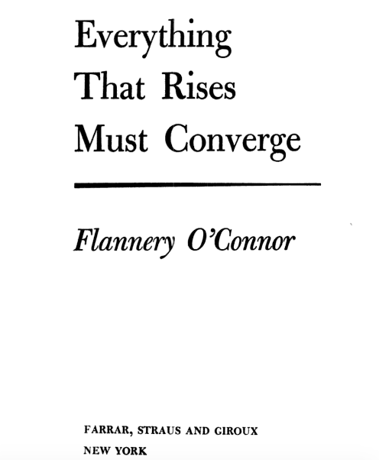
From Google Books
Printed 1965
URL:
https://books.google.com/books/about/Everything_That_Rises_Must_Converge.html?id=d33C-NWNtUQC

Slide 17
CITATION CREATION: ANSWER
O’Connor, Flannery. Everything That Rises Must Converge. Farrar, Straus and Giroux, 1965. Google Books, books.google.com/books/about/Everything_That_Rises_Must_Converge.html?id=d33C-NWNtUQC.

Slide 18
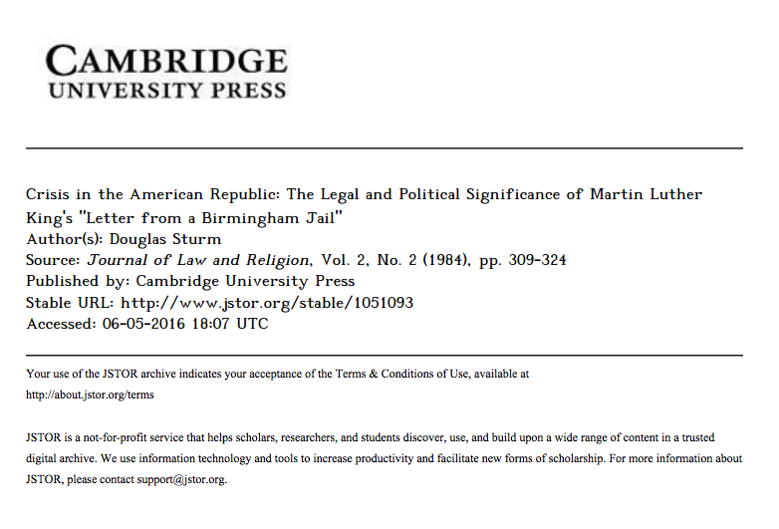

Slide 19
CITATION CREATION: ANSWER
Sturm, Douglas. “Crisis in the American Republic: The Legal and Political Significance of Martin Luther King’s ‘Letter from a Birmingham Jail’.” Journal of Law and Religion, vol. 2, no. 2, Cambridge UP, 1984, pp. 309-324. JSTOR, www.jstor.org/stable/1051093.

