Slide 1
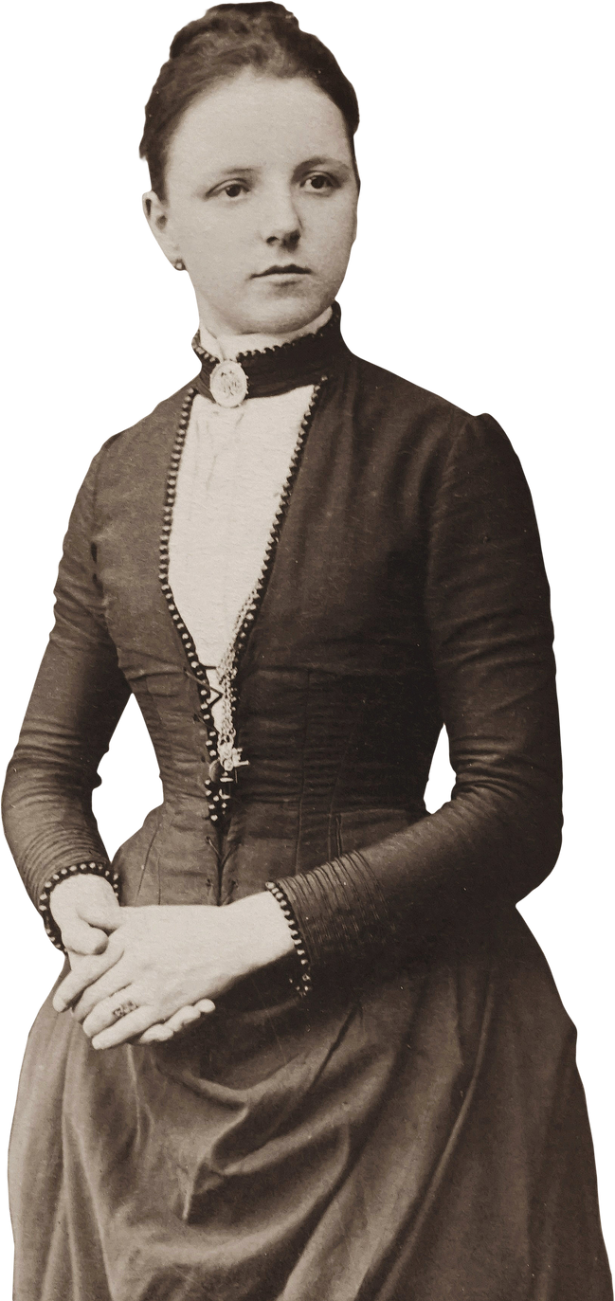
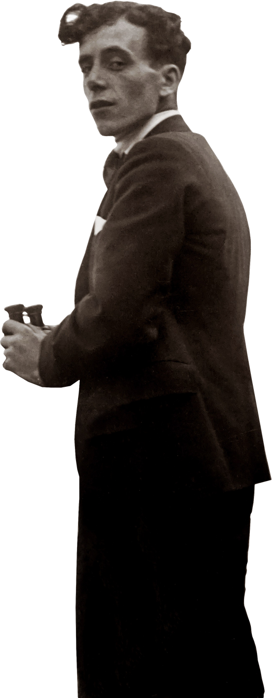
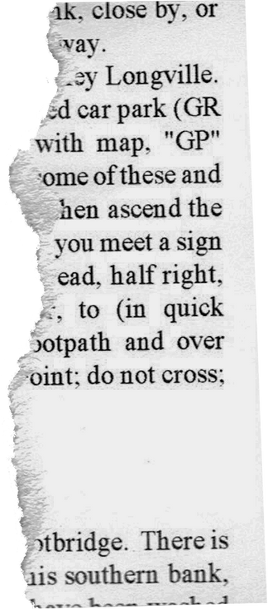

Writing Centers:
A History
2023 November 13
1910 - 2023
Sarah McFeely
WRD 395
Tutoring Inquiry

Slide 2
Research Question:
What is the history behind Writing Center theory and pedagogy? `
  What did the early Writing Center look like?
  How have they changed over time? And what does this say about the future of Writing Center theory?
Table of Contents
I
Carino: Writing Centers through the 1970s
3
II
Redefining the Writing Center: 1970s- 1990s
6
III
Writing Centers in the new millennium
9
IV
Conclusions
12
2
1
Notes:
Peter Carino: well-respected figure within writing center scholarship; written many articles on the history of the WC and modern practices

Slide 3
Writing Centers through the 1970s:
1910s-1920s,
or the “storehouse” period
Writing centers, while today defined as an alternative learning environment, were first based around classroom models. Documented as early as 1904, their early predecessors followed the laboratory method, being housed within the English department (Carino, 1995).
Features of the Early Writing “Lab”
  Funded by a single department, English in most cases
  Where freshman come to get help
  Where the focus is on error
  Which is badly staffed
  ·Which is not held in high esteem in the academy
  Where "bad" people are sent (even remanded)
“The primary purpose of such a facility must be a service to the department which initiated it” (Wallace and Simpson, 1991, p.83)
2
Notes:
WC theory has largely remained the same for a long time ; focusing research on the history of the Writing Center as an instutution (the way its physical space has changed, and the way its perception has changed)
“fix-it shop” for “underprepared and poorly regarded students”
educators sent students there who were deemed as underperforming in their written work. Both students and writing center staff were seen as second-tier: professors didn't have time to bother with grammar and sentence-level issues so they let the WC deal with it

Slide 4


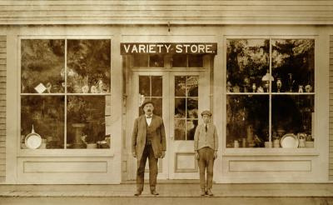
Writing Centers through the 1970s:
1910s-1920s,
or the “storehouse” period
“it is wrong to assume that early writing labs were current-traditional dungeons where students were banished to do grammar drills while hiding in shame from their more able peers. While it is evident that drills were part of the methods of early centers, heuristic and global concerns were equally evident” (Carino, 1995, p.113)
Andrea Lundsford’s model for Writing Center History:
“Storehouses”- early center (pre 70s)- stores grammar, but no theoretical understanding
“garrets”- “student-centered expressionism”
“burkean parlors”- deeper meaning though social construction
(Lundsford, 1991, as cited in Carino, 1995,p. 104)
3
Notes:
Burkean Parlors: (what we might now consider scaffolding)
comes from philosophical metaphor of a never-ending discussion; in the context of learning- education is an ongoing discussion with no clear beginning or end

Slide 5
Writing Centers through the 1970s:
1910s-1920s,
or the “storehouse” period
Lectures, peer-review groups, and one-on-one instruction were all qualities of the early 20th century writing center. By the end of the 1920s, the benefit of the latter two methods was clear (Carino, 1995).
Furthermore, to think that writing centers only began focusing on relationships with students is uninformed, as discourse around the respect of student’s work can be found dating back to 1913 (Cady, 1915, as cited in Carino, 1995). Even in the earliest part of the century, texts surrounding Writing Center practices mention the importance of supporting writers and “underprepared students” (Carino, 1995, p.109)
With the creation of writing labs, students were able to take a hands-on approach to writing. Instead of listening to professors talk about writing, they attempted it themselves (Boquet, 1999).
4

Slide 6
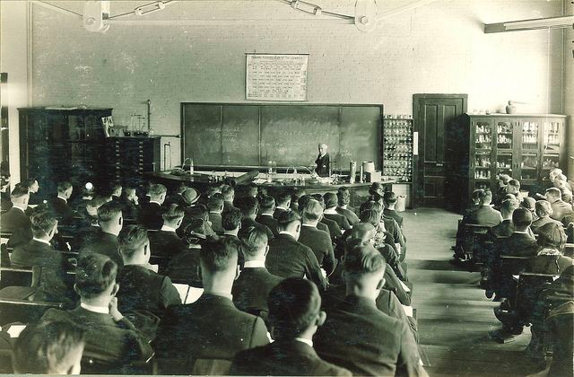

Writing Centers through the 1970s:
1930s-early 1950s,
leaving the “storehouse” period
Around the 1930s, the Writing Center begins to take its more modern form: a separate learning center apart from the English department. This setup facilitated peer review and individualized instruction since Writing Center staff was no longer catering to specific instructions from professors (Carino, 1995). By breaking into its own entity, usage of the Writing Center began to spread across disciplines.
Instructors began to see a benefit of operating outside of “administrative hierarchies”. Eventually, the Writing Lab was recognized as its own entity rather than an extension of the classroom (Boquet, 1999).
5

Slide 7
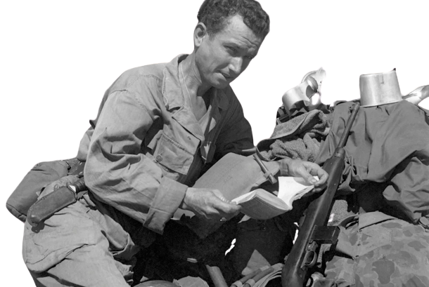
Writing Centers through the 1970s:
1930s-early 1950s,
leaving the “storehouse” period
In the 1940s, WWII served as a backdrop to new theories and practices in the Writing Center. For instance, “Armed Forces English” was a program designed to prepare soldiers for battle within the context of communication. This introduced concepts like speaking, reading, and listening skills into english education (Carino, 1995). Shortly thereafter, “Communications programs shifted the emphasis to social development and the affective domain” (Carino, 1995, p.107). As a result, Writing Centers, closely connected with both areas of study, began to adopt these focuses as well.
In 1949, the Conference on College Composition and Communication (CCCC) was founded. This extended Writing Center scholarship across institutions and began to standardize the practices at Writing Centers (Boquet and Lerner, 2008)
6
Notes:
1940s: people are watching the world as they know it undergo rapid change- practices education change as well
begins trend of the Writing Center adjusting its approaches every time a major event occurs in the world- shows how interconnected the practices at the WC are with everyday life

Slide 8

Writing Centers through the 1970s:
1930s-early 1950s,
leaving the “storehouse” period
Another breakthrough in Writing Center practices occurred at the end of the 1940s: the admittance of graduate student instructors (Carino, 1995). While this can be seen as the beginnings of peer-tutoring, the presence of student teachers wasn’t initially accepted.
Around this time, the University of Denver was criticized for allowing “untrained” tutors to work with students. Upon recieving backlash, of the lab’s founders admitted that “informed people could not possibly permit uniformed ‘clinicians’ [tutors] to tamper with student lives” (Carino, 1995, p.108). Prior to this point, there was no method for training writing center tutors on how to work with students and analyze their work (Carino, 1995). As more issues with student tutors came to light, the importance of proper training courses became evident.
Student tutors at The University of Denver were taught “Rogerian Non-Directive Tutoring”. This is defined as “a person-oriented teaching model” where learning is centered around the self-discovery and understanding of a student’s potential. (American Psychological Association)
7
Notes:
Carl Rogers was an American psychologist who was one of the founders of humanistic psychology

Slide 9

Writing Centers through the 1970s:
1950s-1960s
*Chirp*
*Chirp*
8

Slide 10

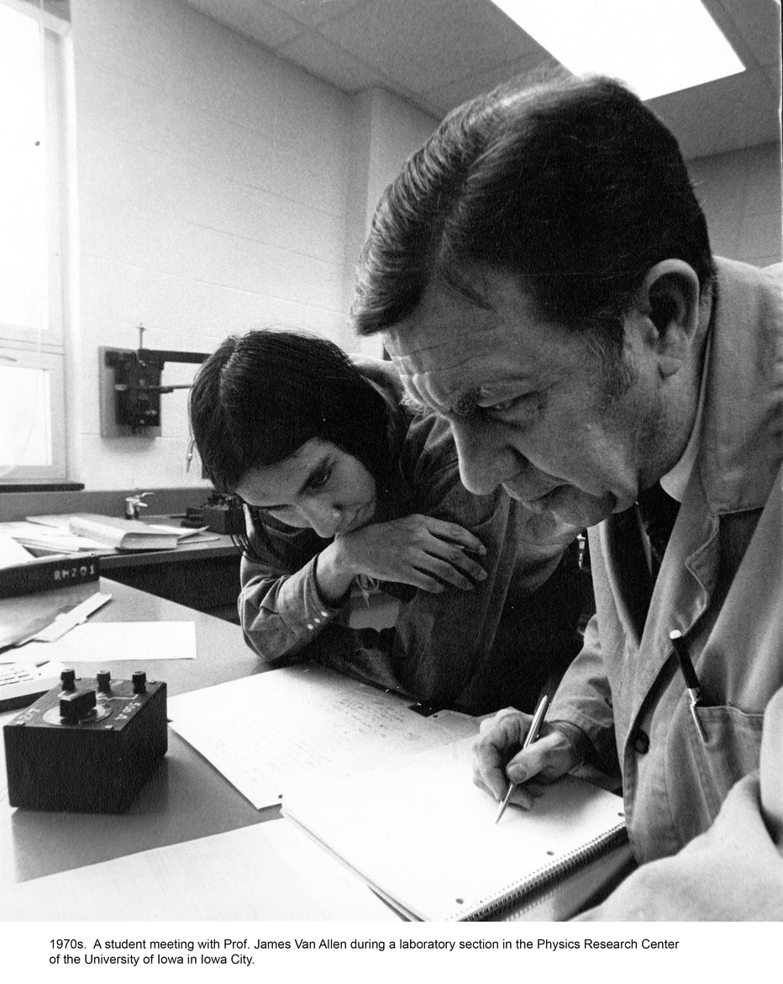

Redefining the Writing Center
late 1960s-1970s,
or the “garrets” period
With the political change and the civil rights movement of the 1960s, the 70s brought about increased diversity on college campuses. Specially, campuses were home to more women, African Americans, and veterans who were affording college for the first time (due to the The Vietnam Era G.I. Bill) (Carino 1996). As a result, students were now coming from different backgrounds, cultures, and socio-economic statuses. This called into question the prior model of Writing Center practice: where instructors taught down to students. At the 1966 Dartmouth Conference, it was proposed that Writing Centers engage in student-focused tutoring, similar to the “garrets” model proposed by Andrea Lundsford (Carino, 1996). At this same conference, early conversations around linguistic diversity began. Teaching Standard English was argued to be a “cultural imperialism” and so expressionism would focus on “fluency rather than correctness” (Carino, 1996).
9

Slide 11
Redefining the Writing Center
late 1980s-1990s,
beginnings of the “Burkean Parlor” period
“The Idea of the Writing Center” by Stephen North is widely considered "the single most important and most quoted essay in writing center scholarship” (Murphy and Law, 1995, p.65). In this work, North expresses displeasure with people inside the English Department, who claim to be familiar with the Writing Center process, and yet beleive the writing center is a place where tutors work independently of students and simply “clean-up” their papers. He cites one study at the University of Pennsylvania where University faculty and Writing Center staff disagreed on the reason of student referral to the Writing Center. Faculty felt that grammar and punctuation was reason enough, while staff prioritized organization, paragraphing, grammar, and style (North, 1984). In a more general sense, he writes that the “fix-it shop” model is “the vital and authentic reflection of a way of thinking about writing and the teaching of writing that is alive and well and living in English departments everywhere” (North, 1984, p.437). As such, he ends his essay calling for declaration of independence from the classroom and from other University entities.
10
Notes:
can see where John Bean’s hierarchy of concern came from, which didn’t come about till the early 2000s)
" when writing center pedagogy has come to characterize our institutions. would it still be possible to distinguish a writing center from an institution recreated in its image” (Micael Rossi, 1995, p.3).
Since university departments can be so unapproachable, the Writing Center serves as an environment where writers can get instruction tailed to their individual needs

Slide 12
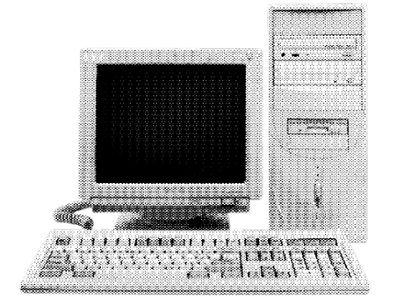

Writing Centers in the new millennium
2000s-now,
or the “Burkean Parlor” period
When addressing recent disruptions to academic writing, the boom in technology across the past 20 years stands out. In the early 2000s, computers, a relatively new addition to the classroom, posed a threat to the way writing had been approached for decades prior. For the first time, educators in and outside of the writing center were forces to confront how convenient technology adjusts the writing process as a whole. An article from 2002 assesses how the computer “relieves the drudgery of teaching writing” (Moran, 2003, p.347). In other words, educators/tutors can look at larger, conceptual topics rather than tedious proofreading tasks (Moran, 2003). Despite these benefits, researchers at the time found that computers interfere with writing abilities, either by distracting writers or interfering with communication with other writers (Moran, 2003).
“some of its greatest strengths is its ability to process vast amounts of textual data in a short period, which can save researchers significant time and effort. In fact, ChatGPT and other NLP technologies have the potential to automate many tasks that were previously carried out manually.” (Dergaa et al., 2023, p.617)
11
Notes:
reflect on times in your appointments where you were able to focus on higher-order issues because the writing was already so strong.
decades of writing center research combined with the benefits of technology solidified the fact that "grammar" was no longer a priority of writing center tutors

Slide 13
Writing Centers in the new millennium
2000s-now,
or the “Burkean Parlor” period
In 2008, “After the Idea of the Writing Center” reassesses North’s original essay nearly 30 years after its initial publication. Despite its age, Boquet and Lerner discuss North’s effect on Writing Center discourse, his work still controlling “current” conversations around theory and pedagogy. “Over twenty years later, given how rarely writing center-related articles have found their way out of WCJ, we can't help but conclude that both audiences' sets of assumptions - College English readers' notions of the lack of relevance of writing center work and "Idea" readers' unsupported contentions for the efficacy of one-to one tutoring - haven't changed much” (Boquet and Lerner, 2008, p.183). While they generally support North’s ideas, they criticize his call for independence. Their article argues for the collaboration between writing centers and the classroom, as practices from each environment affect one another and inform each’s approach to education.
12
Notes:
Lack of new WC articles on the public stage can be attributed to the creation of the WCJ (writing center journal) in 1980, which has narrowed WC articles to an audience primarily composed of Writing Center staff or the field of English Studies (181-182)
Difficult to find Writing Center models or theories that are written in a larger context or alongside other scholarship
similar to Rossi's 90s article that calls for a harmony between the WC and the Classroom
general: this has long been contested space but both entities must exist alongside one another

Slide 14
Writing Centers in the new millennium
2000s-now,
or the “Burkean Parlor” period
Where are we today?
Current scholarship seeks to understand how the attitudes held about writers affects the learning process. As evidenced throughout this course, current research investigates our role as tutors within the “contact zone” of the Writing Center. Navigating cultural, linguistic, and physical differences within peer tutoring, modern theories emphasize learning as a social process. Some look at the physical space within a Writing Center, examining “the material, spatial, and interactive components that make up productive collaborations between writers and consultants” (Brazeau, 2020, p.8). Other researchers have looked at the role of the Writing Center within a particular community. A 2021 article suggests the effect that covid-19 and BLM protests have had on tutoring approaches. Discussing a range of modern scholarship, it explains “that community-engaged writing and literacy centers are uniquely positioned to respond to the needs of the community” (Latta, Raica-Klotz, and Giroux, 2021, p.2). The Writing Center, being an independent learning environment, has the capacity to change and adjust at a much faster rate than entire institutions. This equips tutors with a unique responsibility: to be aware of privilege, power, and oppression within the context of writing.
13
Notes:
mention linguistic diversity

Slide 15

Conclusions
Carino’s Models for Understanding Writing Center History:
1) The Evolutionary Model: Linear view of history where early writing centers prioritized a directive tutoring approach (grammar “fix-it” shop). Through diversification of college campuses and expanded research on the learning process, the collaborative, student-oriented approach has been prioritized by modern writing centers.
2) The Dialectic Model: Views “remediation and inclusiveness - as having been always already in contention” (Carino, 1996, p.37). In other words, it acknowledges the students and educators who have advocated for an accommodationist approach and for student-centered instruction, but have been oppressed by the general recognition of the writing center as a fix-it shop for deficient students
3) The Cultural Model: Combines the prior two together, taking into account different forces that have influences the development of the writing center at various times in history
“writing center history is maddeningly but joyously complicated, and all models are susceptible to the complex temporal and cultural situatedness, and thus political identities, of the individuals and communities who construct them” (Carino, 1996, p.42).
14
Notes:
general takeaways:
specific events throughout history have shaped the way we approach tutoring: since the 40s, the writing center has been one of the first entities on college campuses to respond to large-scale events or changes in the general perceptions of the world at large
by studying where we've been, we can take a more informed approach when confronting the issues of today

Slide 16
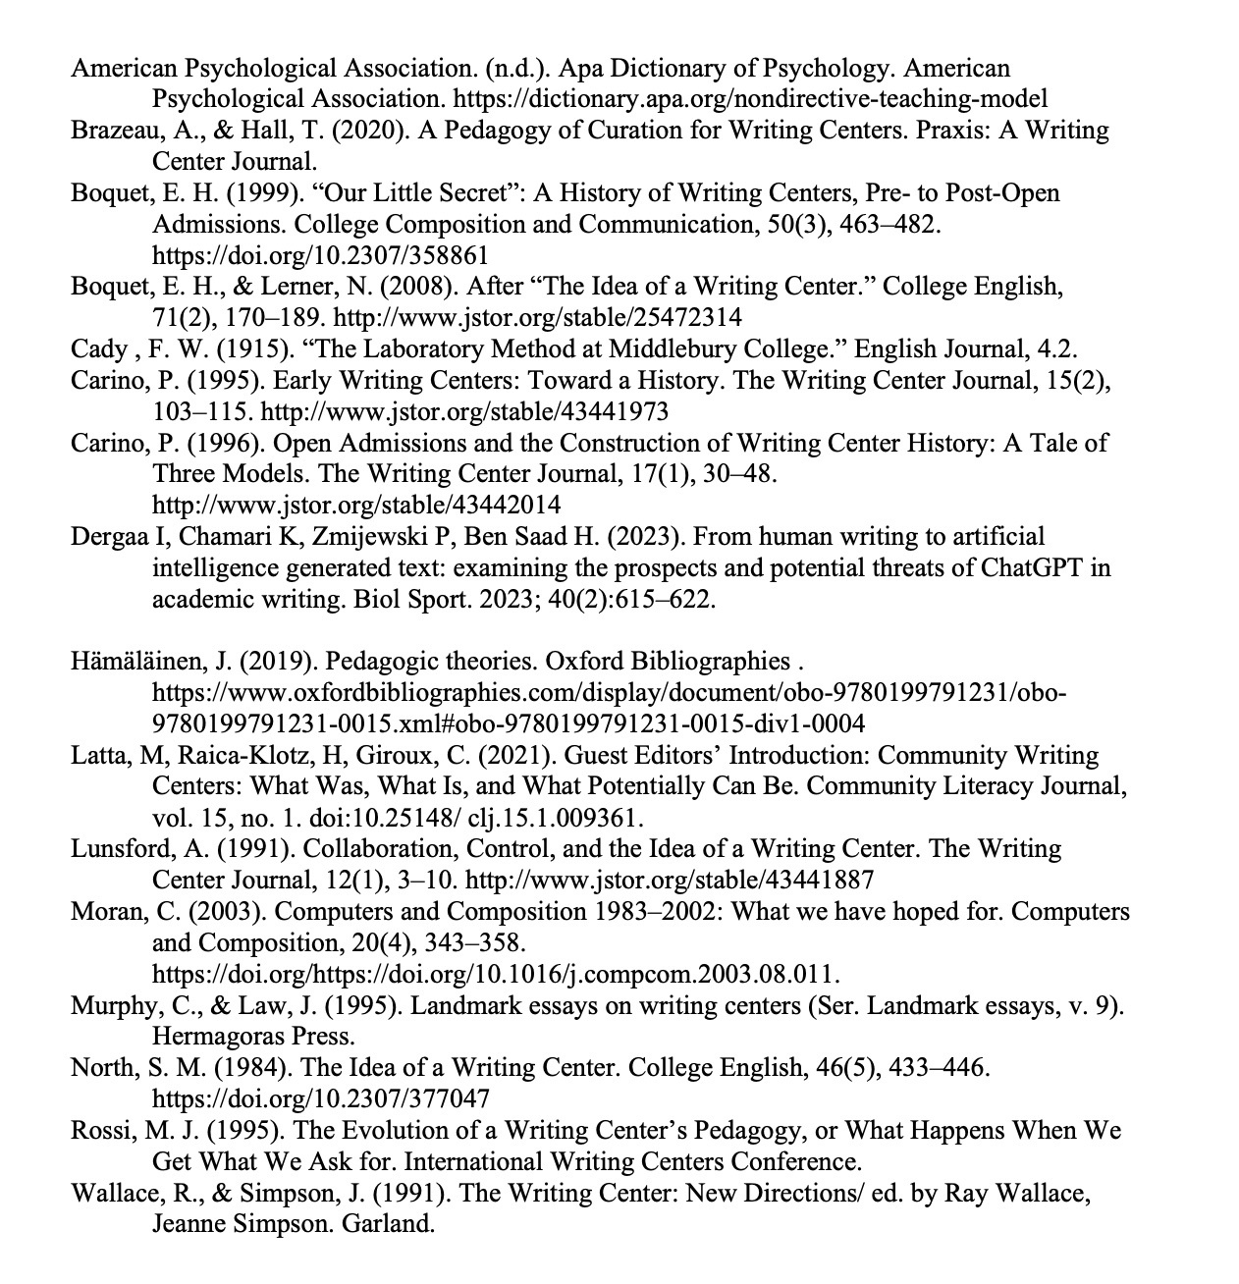
Works Cited

Slide 17
Works Cited

